Slide 1
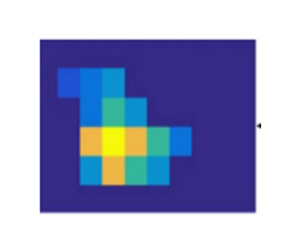
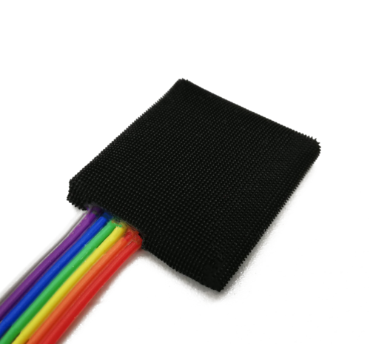

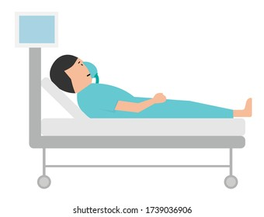
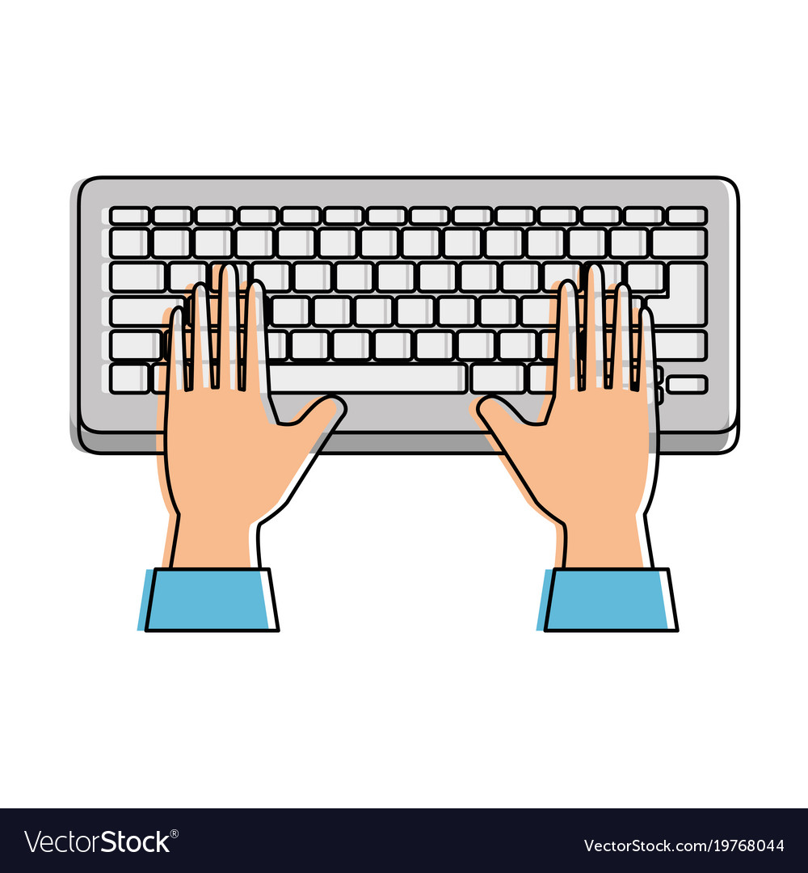
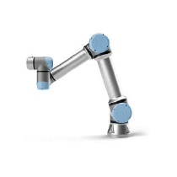
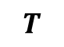
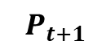
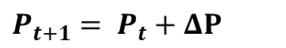
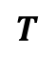
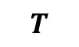
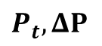

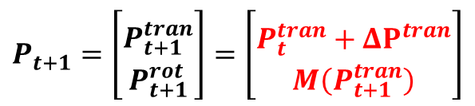
Full Control
$$T$$
$$T$$
$$T$$
GUI
$P_{t+1}= P_{t}+ΔP$
Tactile sensor
Shared Control
Physician
$$T$$
Patient
$P_{t}, ΔP$
$$P_{t+1}=\left[\begin{matrix} \\ P_{t+1}^{tran} \\ P_{t+1}^{rot}\end{matrix}\right]=\left[\begin{matrix} \\ P_{t}^{tran}+ΔP^{tran} \\ M\left(P_{t+1}^{tran}\right)\end{matrix}\right]$$
$$P_{t+1}$$
Input device
UR5

Slide 2
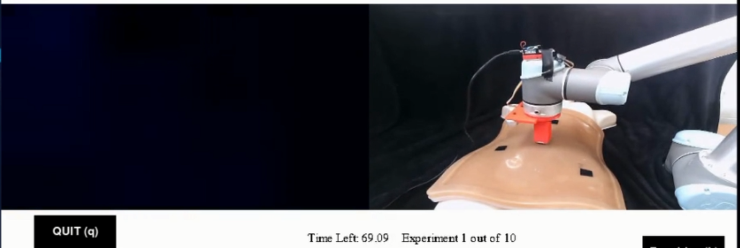
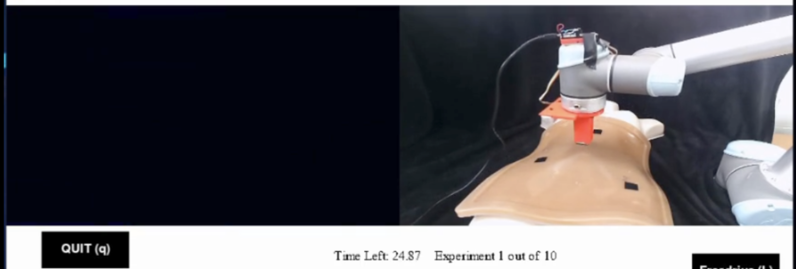
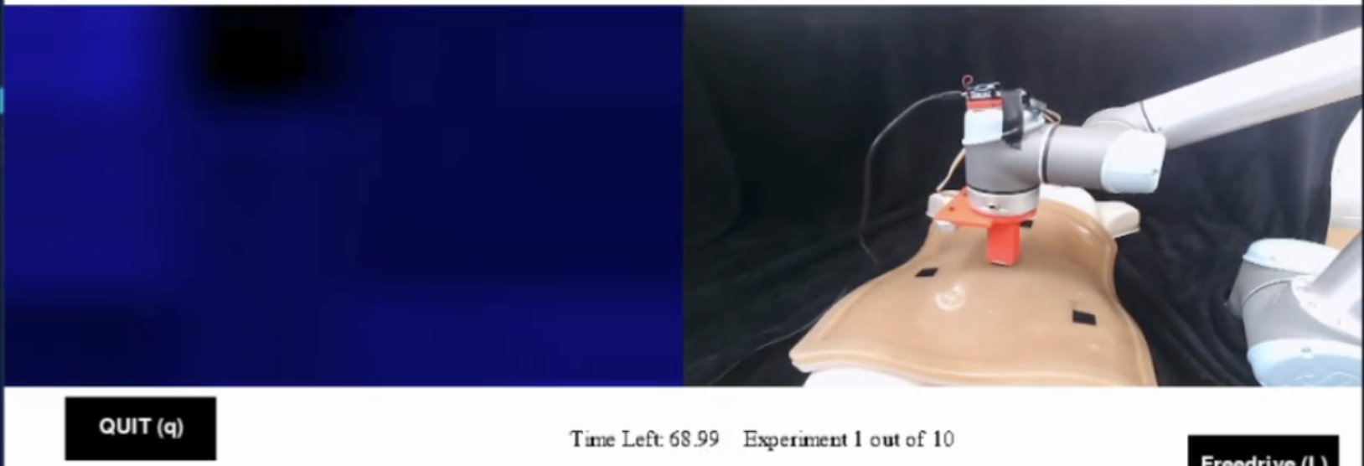
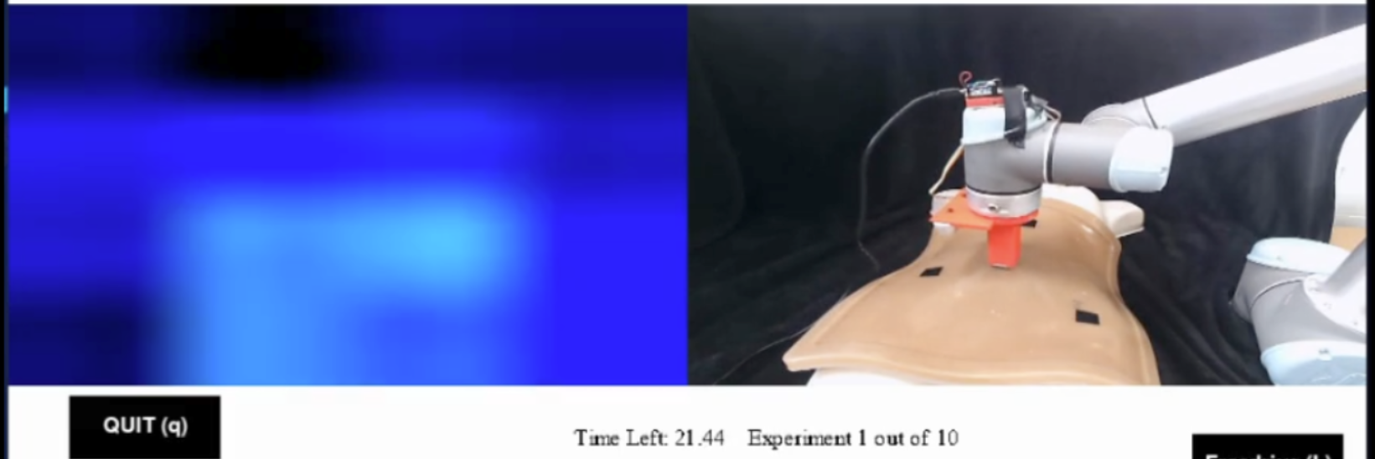
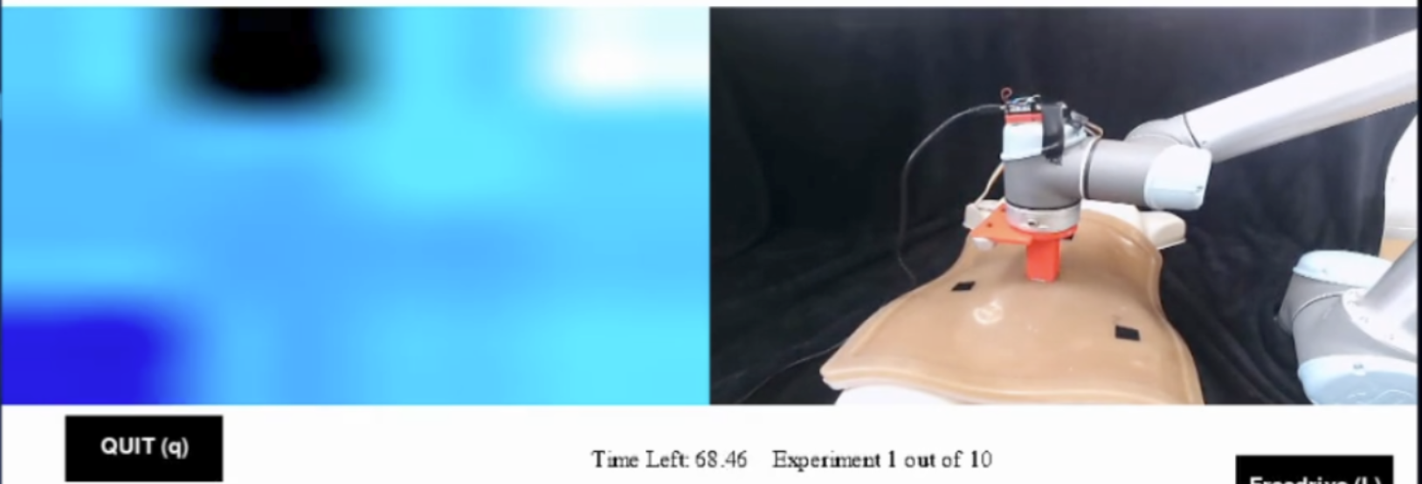
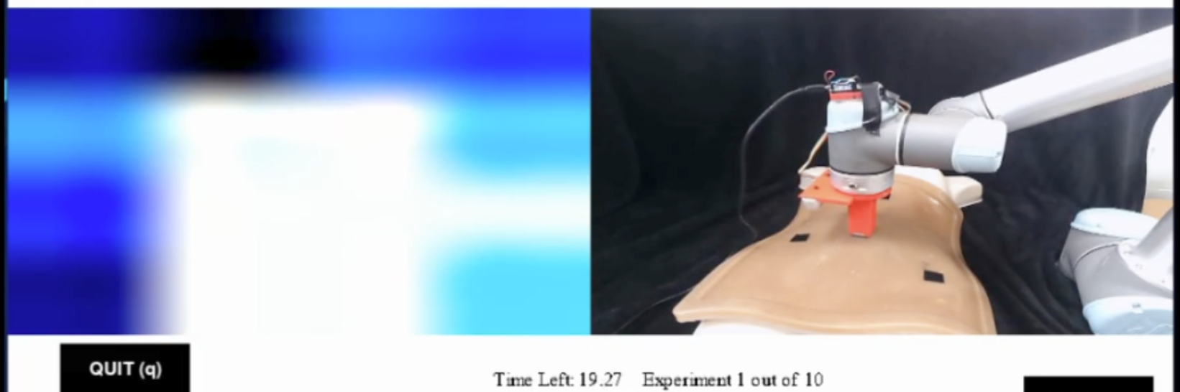
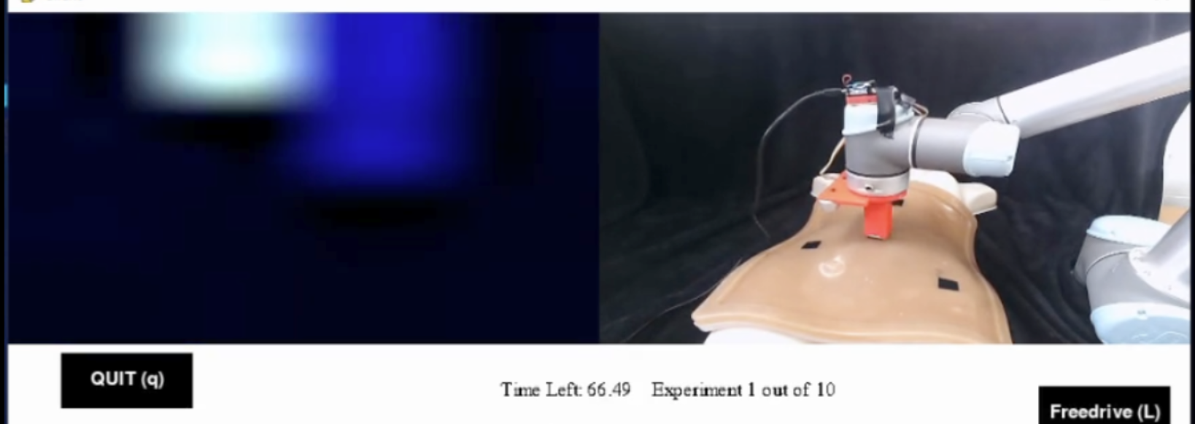
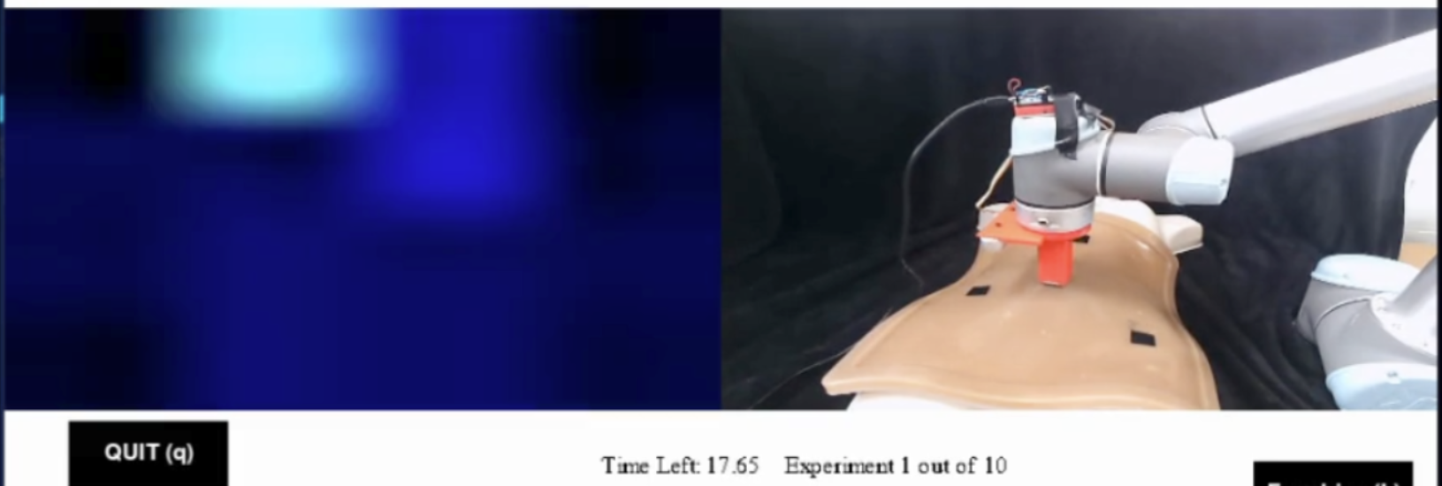
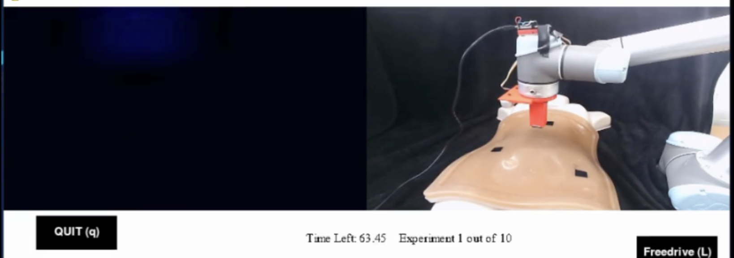
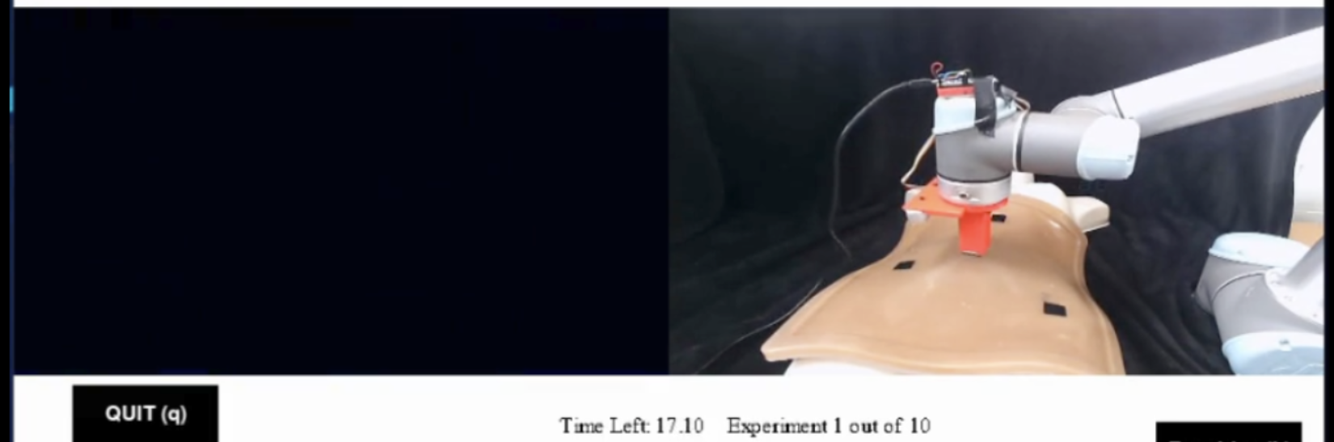
(a1)
(a) Soft tissue
(b1)
(b) Hard nodule
(a2)
(b2)
(a3)
(b3)
(a4)
(b4)
(a5)
(b5)

Slide 3
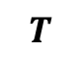
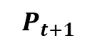
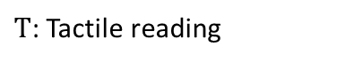
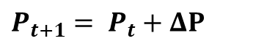
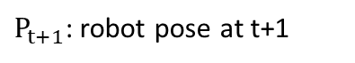
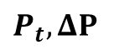
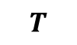
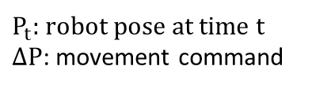
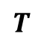
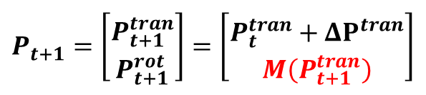
Operator
Leader
Control Algorithm
Follower
Environment
GUI
Full Control
Interpret palpation result
$$T$$
$$T$$
Tactile sensor
Result recorded by tactile sensor
$$T$$
Tactile reading displayed as pressure map
$P_{t+1}= P_{t}+ΔP$
New pose is the addition of old pose and movement
$T$: Tactile reading
Shared Control
Physician
Input device
$$T$$
UR5
Patient
$P_{t}, ΔP$
$$P_{t+1}=\left[\begin{matrix} \\ P_{t+1}^{tran} \\ P_{t+1}^{rot}\end{matrix}\right]=\left[\begin{matrix} \\ P_{t}^{tran}+ΔP^{tran} \\ M\left(P_{t+1}^{tran}\right)\end{matrix}\right]$$
$$P_{t+1}$$
Make decision for next step
$P_{t}$: robot pose at time t
$ΔP$: movement command
New position is the addition of old position and movement, new orientation is deduced from surface geometry function M using new position
Robot perform palpation on patient
$P_{t+1}$: robot pose at t+1

Slide 4
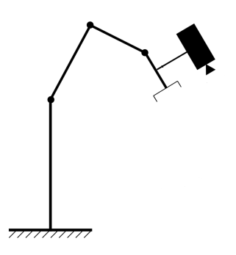
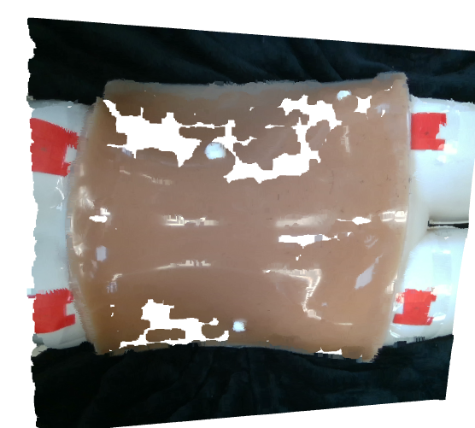
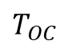
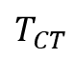
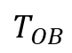
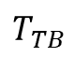
$$T_{TB}$$
Camera
Tool
$$T_{CT}$$
$$T_{OC}$$
$$T_{OB}$$
Robot base
Calibration marker

Slide 5
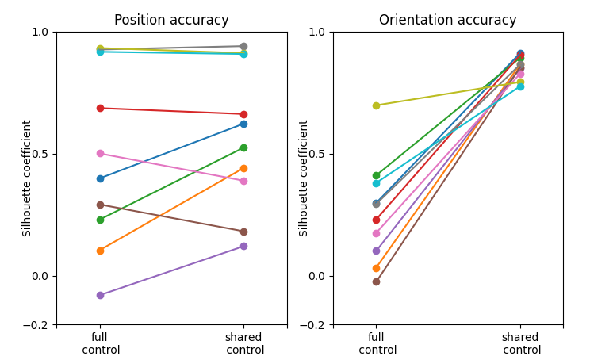

Slide 6
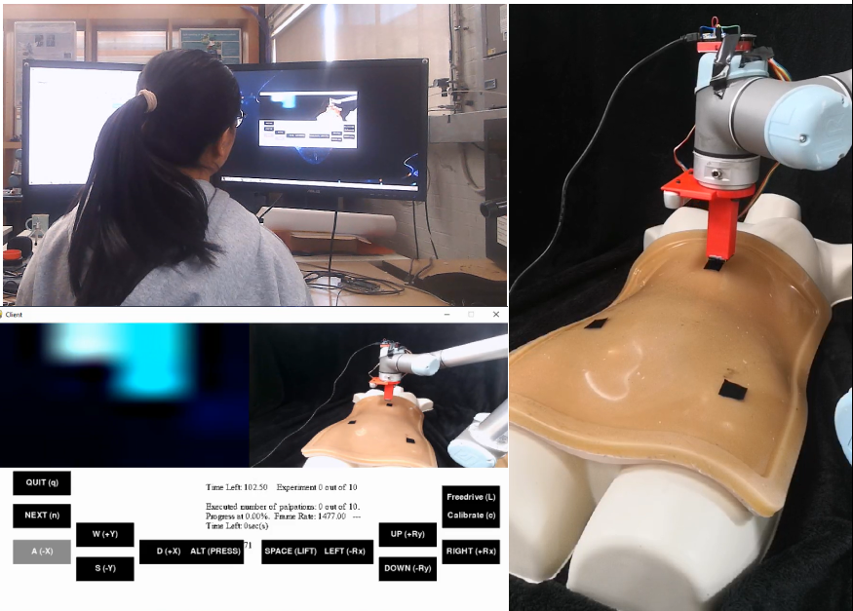
(a)
GUI
(c)
UR5
Keyboard
Depth Camera
(b)
Tactile sensor
Tactile Map
Robot
View
Palpation target
Control Input
Abdominal Phantom

Slide 7
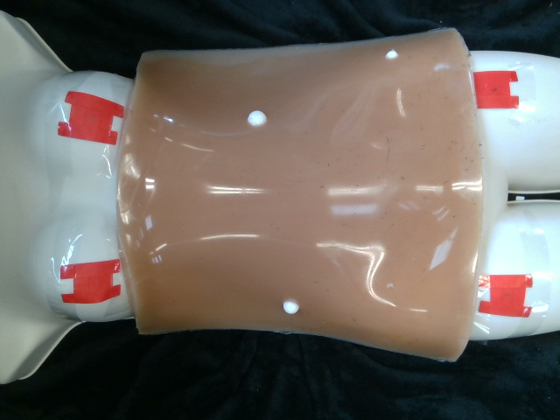
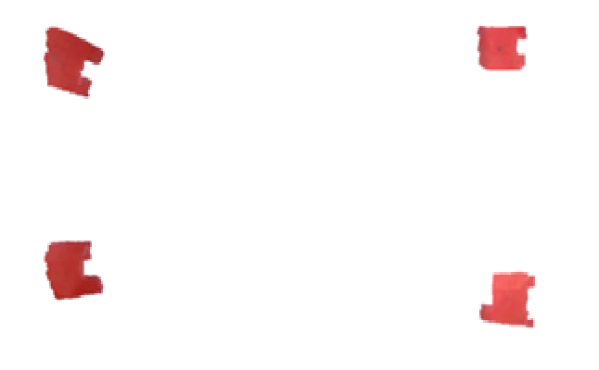
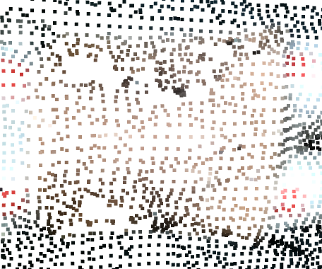
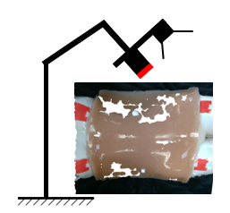
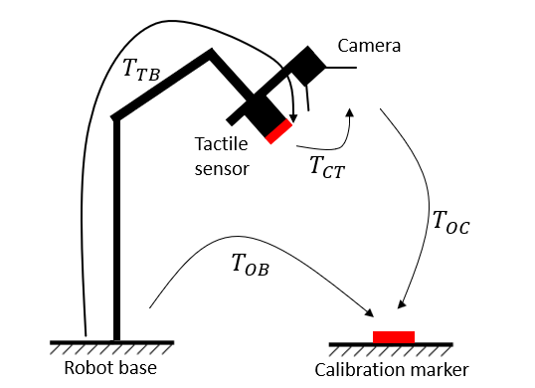
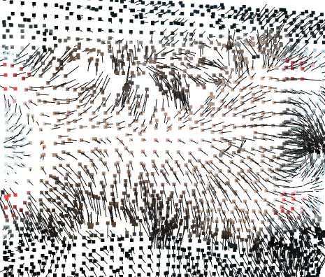
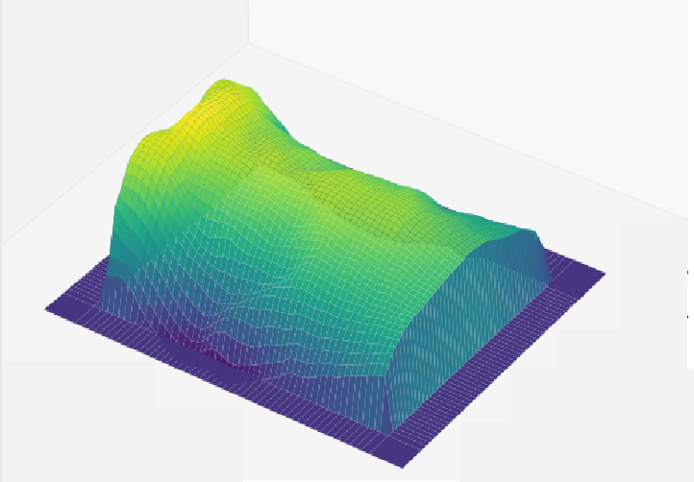
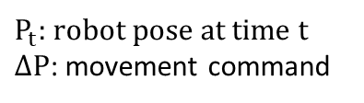
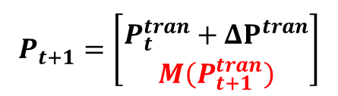

(a)
RGB-D image
(b)
Point cloud (camera frame)
(c)
Calibration marker point cloud
3D reconstruction:
Convert RGB-D image to point cloud
Segmentation:
Threshold point color for calibration marker
Calibration:
Cluster marker points and solve for the calibration matrix
(f)
Point cloud (donwsampled)
(e)
Point cloud (robot frame)
(d)
Calibration matrix ($T_{CT}$)
Downsample:
Output one point per voxel
Calibration:
Convert points from camera frame to robot frame
Normal estimation:
Compute principal axis of adjacent points
(g)
Point cloud (normal direction)
(h)
Grid data (position + normal)
$P_{t}$: robot pose at time t
$ΔP$: movement command
(i)
Control command to robot
Interpolation:
Interpolate point position and normal onto grid
Command generation:
Linear interpolate surface normal at given position
$$P_{t+1}=\left[\begin{matrix} \\ P_{t}^{tran}+ΔP^{tran} \\ M\left(P_{t+1}^{tran}\right)\end{matrix}\right]$$

